Slide 1

Parallel Implementation of
Artificial Neural Networks

Slide 2
Introduction
Artificial neural networks (ANNs) are extremely useful for machine learning in real-life applications.
The basic motivation for the ANN is the human brain, which possesses immense capabilities because of the very large number of neurons the brain holds and the large number of connections that exist in the entire brain.
Connections are likewise of great importance in the ANN, since the entire memory of the ANN takes the form of the connections of varying weights
Parallel processing is a technology that is on a constant rise. We see many algorithms now being made with a parallel implementation to aid the simultaneous working of many units. This naturally gives great performance, with the computation distributed among many nodes.

Slide 3
Back Propagation Algorithm
This algorithm operates in a supervised mode, where the outputs are presented to the system at the time of training along with the inputs.
The BPA adjusts the system bias and weights to optimize performance to the entire system, where the trained ANN better imitates the function desired.
The whole algorithm works in epochs, which are the iterations of the algorithm. At each epoch, the ANN is fed all the inputs and outputs one by one.
The ANN operates in a batch processing mode, and this operation is repeated in ever epoch. At every epoch, generally, the ANN adapts itself well in order to better imitate the function and result in lower errors when presented with the training data set.

Slide 4
Back Propagation Algorithm
The ANN operates in two stages: feed forward and feedback
First comes the feed forward stage, where the given input is applied. All the inputs are given to the system one after the other and the result is calculated.
The second stage is the feedback stage. Here we use the results of the feed forward stage. These results are used to calculate the differences between the actual results and the desired results.
These differences or errors are back-propagated to the previous layers and used to adjust the ANN weights and biases.
In the forward phase, each neuron acts on the input that is given to it. The output of this neuron is propagated to the next-layer neuron of the network. Each neuron consists of a number of connections from the previous layer.

Slide 5


Back Propagation Algorithm
Let these connections be numbered 1, 2, 3…n. Each connection has a weight Wi associated with it. Each neuron performs two steps. The first is the weighted summation, shown in Equation :
Here, O1 is the first level output of the neuron
Wi is the weight of ith connection
xi is the ith input of this neuron
The second is the addition of nonlinearity to the output. This is done by passing the input to a nonlinea rfunction f(x) as is given in Equation

Slide 6


Back Propagation Algorithm
Usually we use the sigmoid function as the nonlinear function. This function is given in Equation :
In the backward phase, the error is calculated and is propagated backward to all the previous layers. This error is used to make adjustments in the weights of the neurons. The error of a given output node is denoted by δ. This is given in Equation :

Slide 7


Back Propagation Algorithm
Here O2 is the output received in forward phase
Od = Desired Output
The weight of this neuron is changed by a small fraction ΔW. Here ΔW is given by Equation :
Here η′ is the learning rate.
The final updated weight is given by Equation :

Slide 8
Data Set Partitioning
Data set partitioning tries to distribute the training data among the processing elements (PEs). Each of the PEs receives some part of the training data and is supposed to train itself by this data.
When all the PEs have trained themselves sufficiently well, the results are combined and are then communicated to all the PEs. This helps all of them update the weights and the biases.
In order to update the weights and the biases, each PE takes the mean of all the weights calculated by the different PEs. This is given in equation 18.7. The final resulting weights and biases are reflected in all the copies of the ANNs. The update is done by the PE itself in its copy of the ANN once it knows the calculated weights of all the PEs.

Slide 9

Data Set Partitioning
Here Wij is any weight from any node i to any node j in layer k
l is any of the data set partitions
N is the number of data set partitions
A major point of concern in this type of partitioning is the communication between the nodes. The communication needs to be kept at a minimum in order to minimize the communication overhead.
If there is a lot of communication, making and breaking of connections, etc., it is possible that these times spent communicating data may turn out to be much more than the total time saved in partitioning.

Slide 10
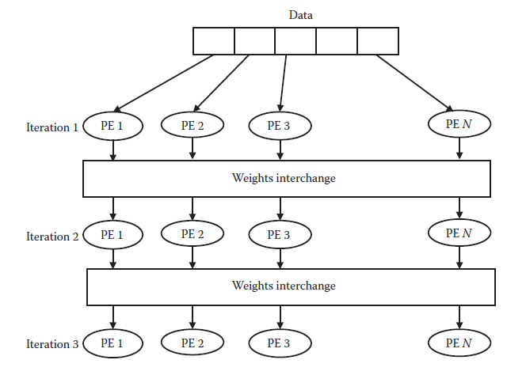
Data Set Partitioning
Data set partitioning

Slide 11
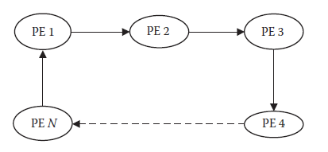
Data Set Partitioning
Communication in data set partitioning

Slide 12
Layer Partitioning
Layer partitioning is another type of partitioning. Here we partition or divide the layers of the ANN. Each layer or set of layers is allotted to a separate PE that carries forward all the computation of these layers.
It needs to be seen here that a layer will be able to work for some input only after the preceding layer has finished working with it.
The results are supplied from the preceding layers to the next layers, and in this manner the transfer of information is carried out. This happens in both the feed forward and feedback stages.
In order to maintain parallelism, the different layers work in a pipelined architecture. The different layers work on different data items. Once the first layer makes its calculations for the first data item, it communicates the results to the second layer.

Slide 13
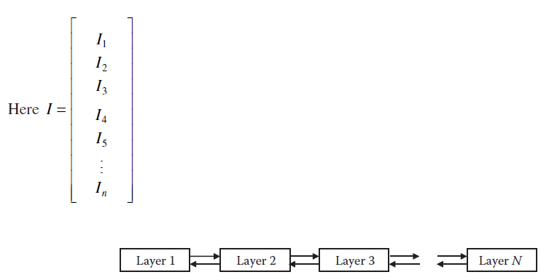
Layer Partitioning
The communication follows a similar approach, where the computations are transferred from a backward layer to a forward layer (in the forward pass) and a forward layer to a backward layer (in the backward pass).
How layer partitioning works.

Slide 14
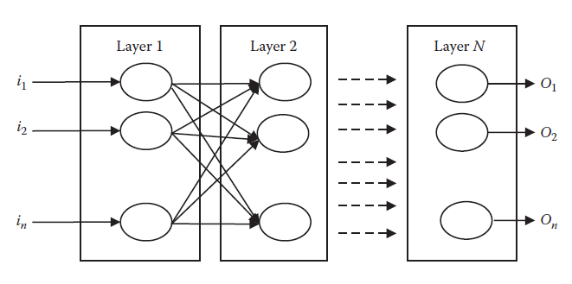
Layer Partitioning
The layer breakup of a neural network

Slide 15
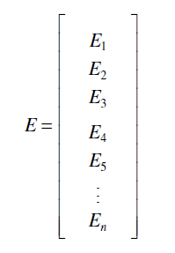
Layer Partitioning
Similarly in the backward phase we propagate the array of desired valued backward. The error E that is propagated from one layer to another is given in equation :

Slide 16
Node Partitioning
In this type of partitioning we try to partition or divide the nodes of the various layers horizontally. Each partition is handled by a separate PE. The partitioning consists of nodes from all layers.
Here the computation is slightly more complex. The computation has to precede layer-by-layer. Hence at the start, all first nodes of various PE may start their functioning. Once this is done, then only the second nodes will get a chance to operate.
The processing propagates simultaneously among all processing elements, from one layer element to the other.
The weights are usually stored reputedly to save time. Due to the number of connections, the total time is usually greater. The communication is from one processing element to all the processing elements as the connections may exist that require such a data transfer.

Slide 17
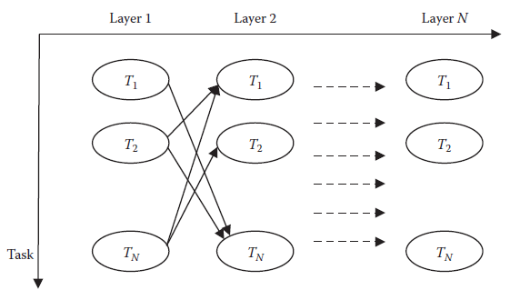
Node Partitioning
The working of node partitioning.

Slide 18
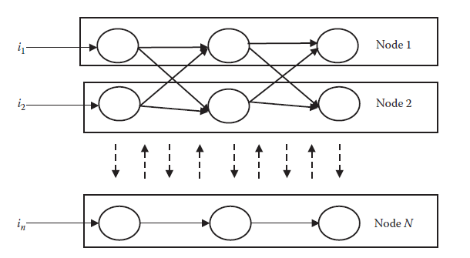
Node Partitioning
The structure of node partitioning.

Slide 19
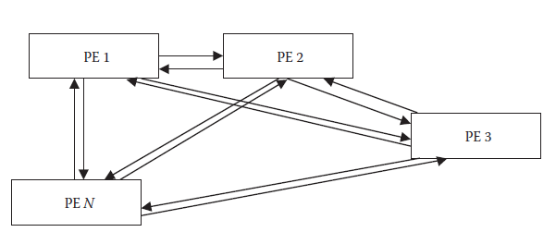
Node Partitioning
Communication in node partitioning.

Slide 20
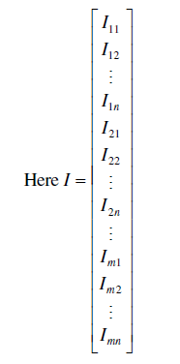
Node Partitioning
This is the straight input as arrays from the various nodes that are working. The equation shows m processing units. Any processing unit gets m – 1 arrays of inputs from other units and 1 from its own unit.

Slide 21
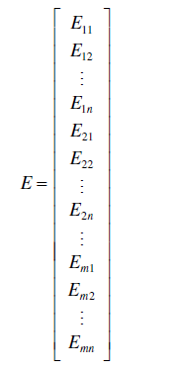
Node Partitioning
Similarly in the backward phase we propagate the array of the desired valued backward. The error E that is propagated from one layer to another is given in Equation :

Slide 22
Hierarchical Partitioning
It is natural that the individual systems or partitioning techniques face problems that restrict their performance. This necessitates more intelligent partitioning techniques that might further give a performance boost.
Here we first of all partition the data as per the data set partitioning norms. After this partitioning has been applied, the various PEs get a copy of the data that they need to train.
This is further broken down into node partitioning or layer partitioning.
A general method for applying this partitioning technique is to use half of the PEs for the node partitioning and the other half for layer partitioning.
When the system is asked to train itself, the first job is the data set partitioning. The data set is divided and distributed among all the PEs of the data set partition. Each is given its own share of the data, along with a copy of the ANN with initial weights and biases.

Slide 23
Hierarchical Partitioning
Self-Adaptive Approach
Systems should be self-adaptive because the various PEs may have different processing powers. Some may be able to perform very fast, while others may take time for the same computation. This difference in the processing powers needs to be taken care of. Also the performance of the PEs may change over time.
All these temporal variations in the speed of the systems also have an impact on the performance of the entire system. Hence there is a need for performance optimization in such conditions in order to reduce the idle time of every PE.

Slide 24
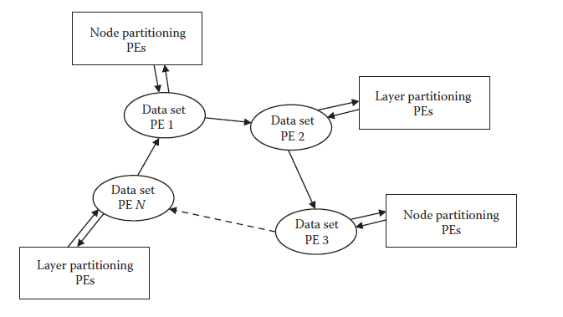
Hierarchical Partitioning
The general structure of hierarchical partitioning.

Slide 25
Hierarchical Partitioning
The general algorithms would not give optimal performance in such casesThe adaptation will enable us save valuable time. It is carried out by varying the load of the workstations.
If we find that the workstation is performing very well, we increase its workload. If a PE is not able to perform that well, we reduce its workload. The performance here is seen in relative terms.
The communication required for this system is carried out in peer-to-peer mode. Each workstation informs the next workstation of its performance characteristics. This cycle goes for n – 1 cycles.
The information on both weights and performance goes simultaneously.
This is communicated by the first node to the server at the desired frequency. The server studies the performances and then redistributes the work load among all.

Slide 26

Hierarchical Partitioning
The performance here is the actual time taken by the nodes in execution, neglecting the times it was waiting for the response of another node. The number of test cases ni to be given to any node i may be calculated as given in Equation :
Here ni = Number of test cases to be given to node i
N = Total number of test cases
pi = Performance of node i
T = Total sum of performances (Σ pi)

Slide 27

Hierarchical Partitioning
Here pi is calculated as the difference between the processing time of that node and the time taken by serial execution of the algorithm. This is given in Equation :
Here ti = Processing time of node i
S = Time taken by serial execution of the algorithm
The last node gets the remaining number of test cases (T – Σni)

Slide 28
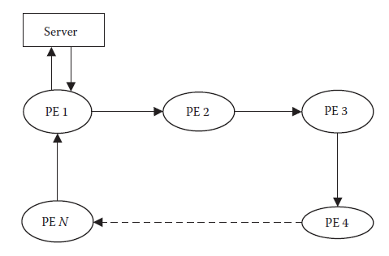
Hierarchical Partitioning
The server/client self-adaptive model.

Slide 29
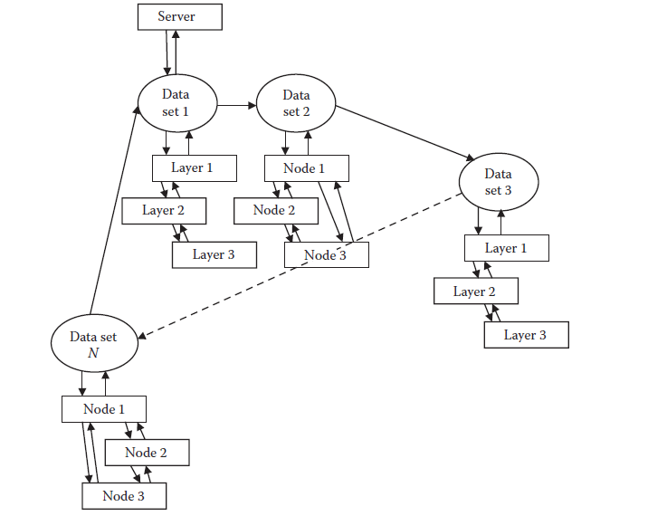
Hierarchical Partitioning
The connection referred to here involves the sockets used between the PEs for the transfer of information from one PE to the other. These connections are established as per the decided architecture design at the start of the algorithmic run itself.
Connections in the
algorithm.

Slide 30
Hierarchical Partitioning
Working
The basic purpose of the algorithm is to train the ANN using the BPA. This happens in a parallel manner by using the various kinds of partitioning that we studied. In this section we come to grips with the basic working of the resulting system that is able to use the parallel concepts well and result in a performance boost.
The data set partitioning is made active. Here the data are partitioned and divided among the various data set partitions or PE sets. All the data are circulated on the circular ring of the data set partition. The data set partition PEs take the required number of test cases and pass the rest to the next nodes. After this step, all the nodes involved in data set partitioning have a data set with them. Also each one of them gets a copy of the ANN comprising the architecture, weight, and biases.

Slide 31
Hierarchical Partitioning
Results
The hierarchical algorithm was tested against a synthetic problem to study its working and effect on the performance of the system. Java was used as a platform for the implementation, and socket programming was used for the transfer of the information across the discussed connections.
Here a synthetic data set was generated for the training of the ANN. The data set generated was by taking random inputs.
Hence the task of the ANN was to imitate the function given by Equation :

Slide 32

Hierarchical Partitioning
The performance of this algorithm was matched against the performance of a single-processor singe system where the simple BPA was made to run. The times of execution for both these systems comprising multiple and single workstations were compared to know the amount by which the parallel systems proves to be better.
The two systems are compared by the speedup. This is a ratio between the times taken by the single workstation algorithm (a sequential algorithm) and a multisystem algorithm or a parallel algorithm.
This ratio is given by

Slide 33
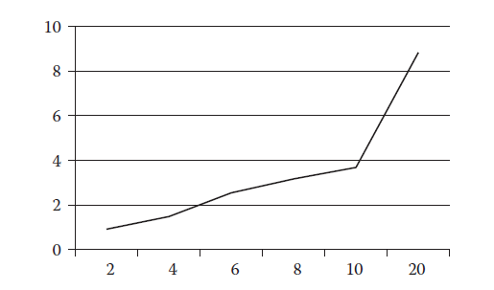
Hierarchical Partitioning
Speedup vs. number of processing elements: Input 1.

Slide 34
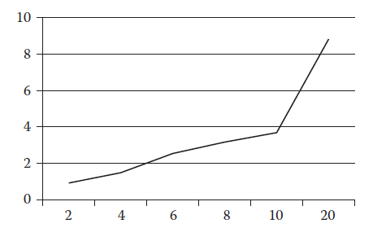
Hierarchical Partitioning
Speedup vs. number of processing elements: Input 1 without self-adaptive approach.

Slide 35
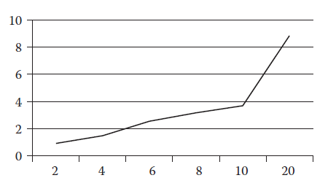
Hierarchical Partitioning
Speedup vs. number of processing elements: Input 2.

Slide 36
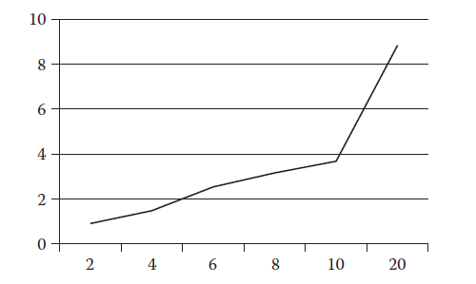
Hierarchical Partitioning
Speedup vs. number of processing elements: Input 2 without self-adaptive approach.

Slide 37
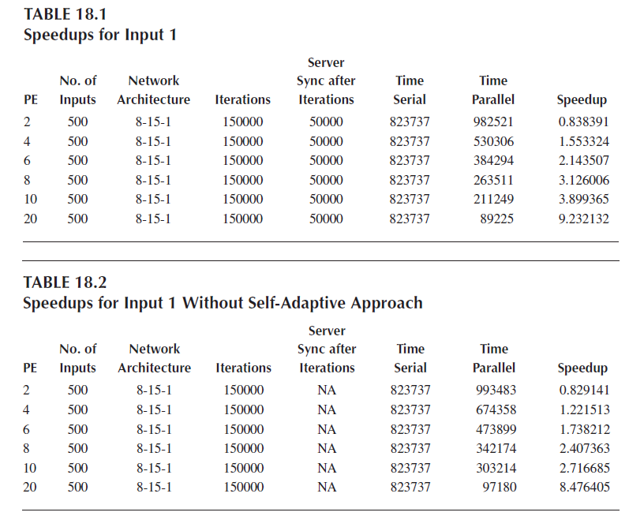
Hierarchical Partitioning

Slide 38
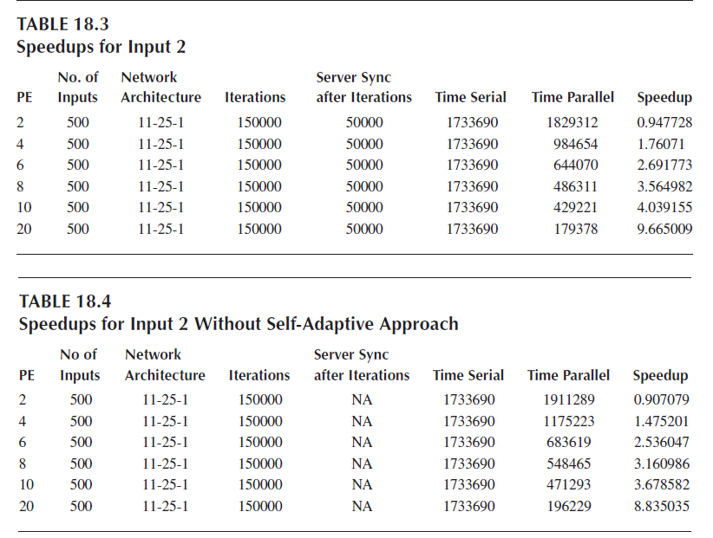
Hierarchical Partitioning

